Slide 1

EMPLOYEE SALARIES FOR DIFFERENT JOB ROLES
Adepegba David .A.

Slide 2


Agenda
A
Introduction
Dataset Details
Data Transformation
Visualization
Insight
Recommendations

Slide 3

Introduction
Understanding employee salaries by job role is crucial for organizations to ensure fair compensation, attract and retain top talent, and maintain a competitive edge in the market. This presentation provides an in-depth analysis of employee salaries across various job roles, offering insights into current trends, patterns, and disparities. By examining salary data, i aim to identify areas for improvement, optimize compensation strategies, and enhance overall organizational performance.

Slide 4
Dataset Details
Work Year: The year of employment.
Experience Level: The experience level of the employee.
Employment Type: The type of employment.
Job Title: The job title or position of the employee within the company.
Salary: The salary amount in the local currency.
Salary Currency: The currency in which the salary is denoted.
Salary In USD: The equivalent salary amount in USD (United States Dollars).
Employee Residence: The location of the employee's residence.
Remote Ratio: The percentage of remote work allowed for the position.
Company Location: The location of the company.
Company Size: The size of the company.

Slide 5

Data Transformation
Replace "country code" with "country name."
Experience Level
EN - Entry Level
Employment Type
FT - Full Time
Company Size
L - Large
Change the employee reside code to the employee reside country name of the employee
Company Location
Employee Residence
ML - Mid Level
SE - Senior Level
EX - Executive Level
PT - Part Time
CT - Contract
FL - Freelancer
M - Medium
S - Small

Slide 6
Visualization

Slide 7
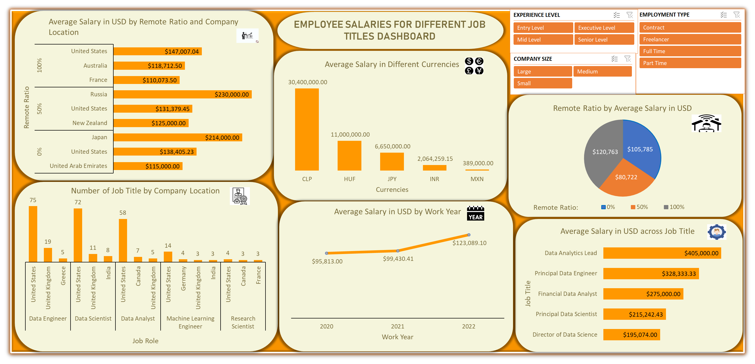


Slide 8

Average Salary in USD by Remote Ratio and Company Location

Slide 9

Number of Job Title by Company Location

Slide 10

Average Salary in USD by Work Year

Slide 11

Average Salary in Different Currencies

Slide 12

Remote Ratio by Average Salary in USD
Remote Ratio:

Slide 13

Average Salary in USD across Job Title

Slide 14
Insight
The highest average salary in USD is found in Russia, where 50% of salaries are earned remotely.
Data Engineer is the most common job title in the United Kingdom, with 75.
The highest average annual salary in USD is $123,089.10 in 2022.
At 30.4 million, CLP has the highest average salary in terms of other currencies.
With a remote ratio of 0%, the highest average salary in USD is $105,785.
With an average pay of $405,000 USD, the Data Analytics Lead has the highest typical salary.

Slide 15
Recommendations
Based on my analysis, we recommend that organizations consider the following strategies to attract and retain top talent:
R
Offer competitive salaries: With the highest average annual salary in USD being $123,089.10 in 2022, organizations should ensure that their compensation packages are competitive to attract top talent.
Embrace remote work: With 50% of salaries in Russia being earned remotely, organizations can consider offering flexible work arrangements to attract talent from a wider geographic pool.
Invest in data roles: With Data Engineer being the most common job title in the UK and Data Analytics Lead having the highest average salary, organizations should consider investing in data talent to drive business growth.4
Consider currency exchange rates: When hiring talent from other countries, organizations should consider the exchange rates to ensure fair compensation. For example, the highest average salary in terms of other currencies (CLP) is 30.4 million.
By implementing these strategies, organizations can stay competitive in the job market and attract the best talent to drive business success.

Slide 16
Thank you

